Slide 2
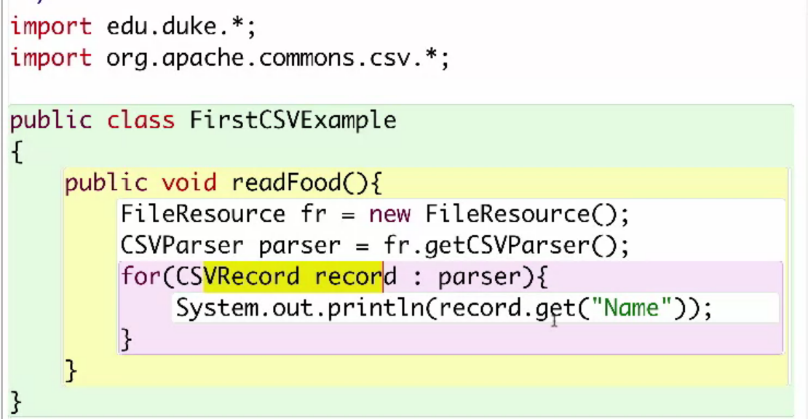
Read single csv file
Notes:
CSVParser is a class which is part of the “org.apache.commons.csv” library
Csvrecord is another class from same library

Slide 3
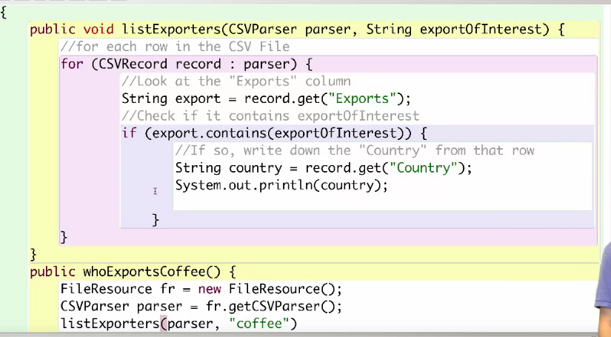
Cont.

Slide 4
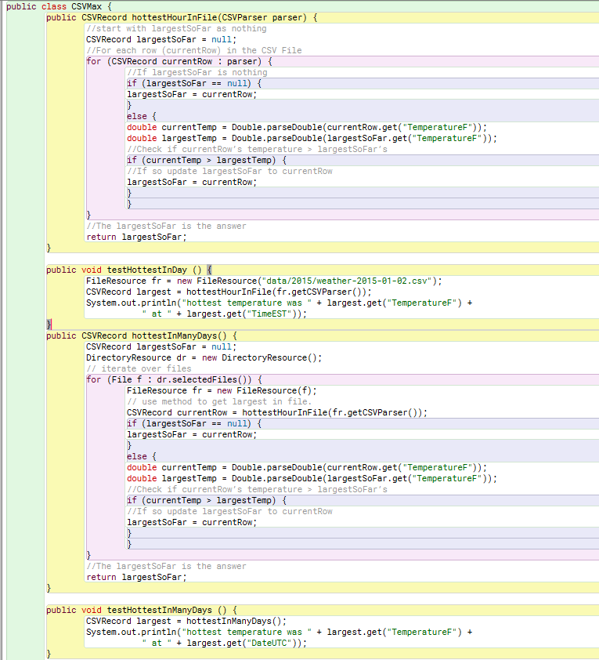
Read multiple files(directory)
Detail can be found in “hottestTmpMany” project

